Slide 1
UIControl in Swift

Slide 2
OVERVIEW
01
MECHANISM AND TYPES
02
TABLE OF CONTENTS
03
INITIALIZATION AND USING

Slide 3
01
OVERVIEW

Slide 4
UIControl put it simply, a class is the base class for visual elements that convey a specific action or user's intent (drag, button click, etc.).
Controls implement elements such as buttons and sliders, which your app can use to facilitate navigation, gather user input, or manipulate content.
Controls use the target-action mechanism to report user interactions to your app.

Slide 5
02
MECHANISM AND TYPES

Slide 6
MECHANISM
it is a class that gives the user the ability to interact with the view that is presented to the user. UIControluses a mechanism called Target-Action to deliver user actions to the app.
This Target-Action mechanism is addTarget(_:action:for:)implemented using methods. As parameters, it passes the object responsible for the action, the method that defines the action for the action, and for which action ( .touchUpInsider, .valueChangedetc.) the method is to be called.
The addTarget method has three parameters, the first parameter is the object that define the event process function, the second parameter is a function name selector, the third parameter is an event name. In below example code, when the touchUpInside event happened on the button, it will invoke current object’s ( ViewController object ) clickButtonThree function.

Slide 7
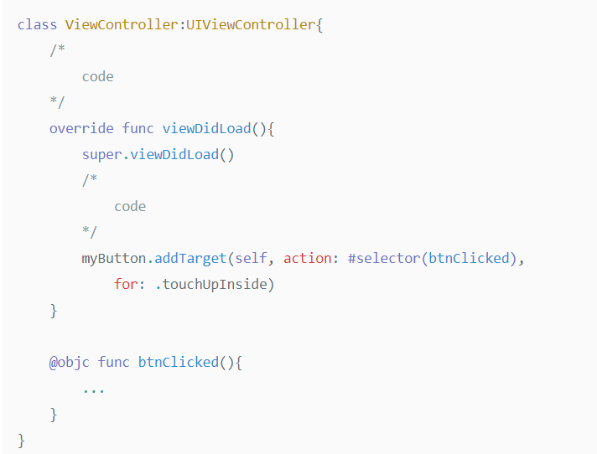
From this code, UIButton excutes myButton.addTarget(self, action: #selector(btnClicked), for: .touchUpInside) method which invokes action trough btnClicked()
As a result, if you add target method, and then action would be invoked when UIcontrol.event .touchUpInside is satisfied.

Slide 8
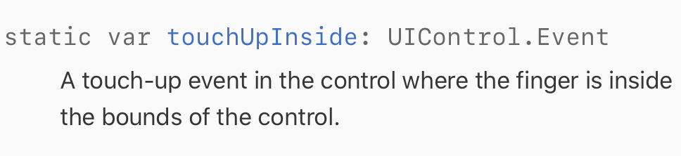
UIControl.event
Constants describing the types of events possible for controls.
Developer can choose which event invoke actions from target.
For example, if you add .touchUpInside(UIControl.event) on addTarget method, action will be invoke when you click inside of button.
Because there are so many kinds of UIControl.event, it will be better for us to find event which is adapt for your situation in apple document.

Slide 9
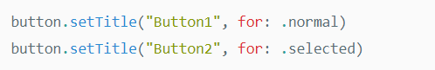
UIControl.state
Constants describing the state of a control.
UIControl can have multiple states.
User can set different actions depend on states.
From this code, before select the button it shows “Button1” as title.
After select button, button shows “Button2” as title.
.normal and .selected is UIControl.state properties.
Especially, .normal is default property. When the control have .normal property, other properties should be false.

Slide 10
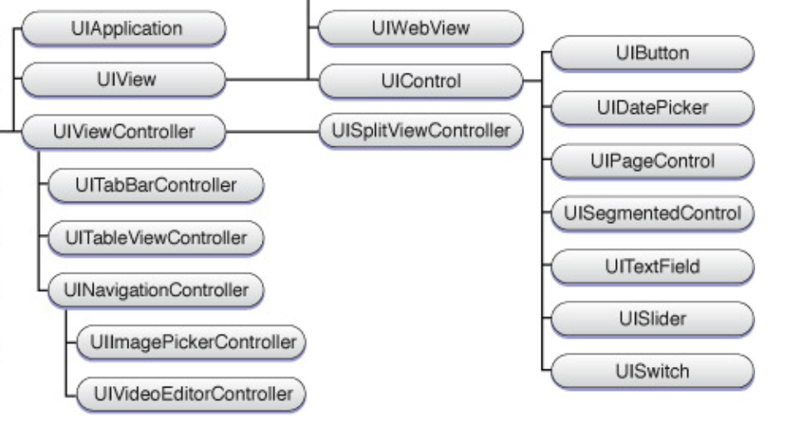
TYPES

Slide 11
03
INITIALIZATION AND USING

Slide 12
UIButton
❖ A control that executes your custom code in response to user interactions.
❖ When you tap a button, or select a button that has focus, the button performs any actions attached to it. You communicate the purpose of a button using a text label, an image, or both.
❖ The appearance of buttons is configurable, so you can tint buttons or format titles to match the design of your app.

Slide 13
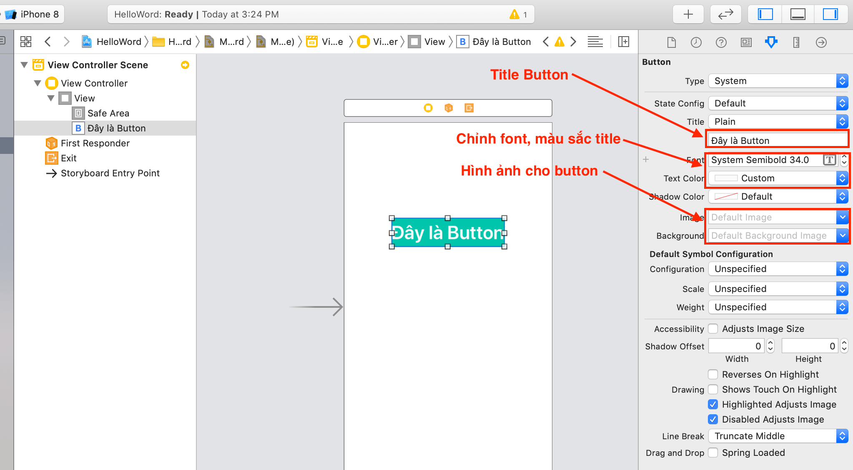
Create UIButton by drag and drop

Slide 14
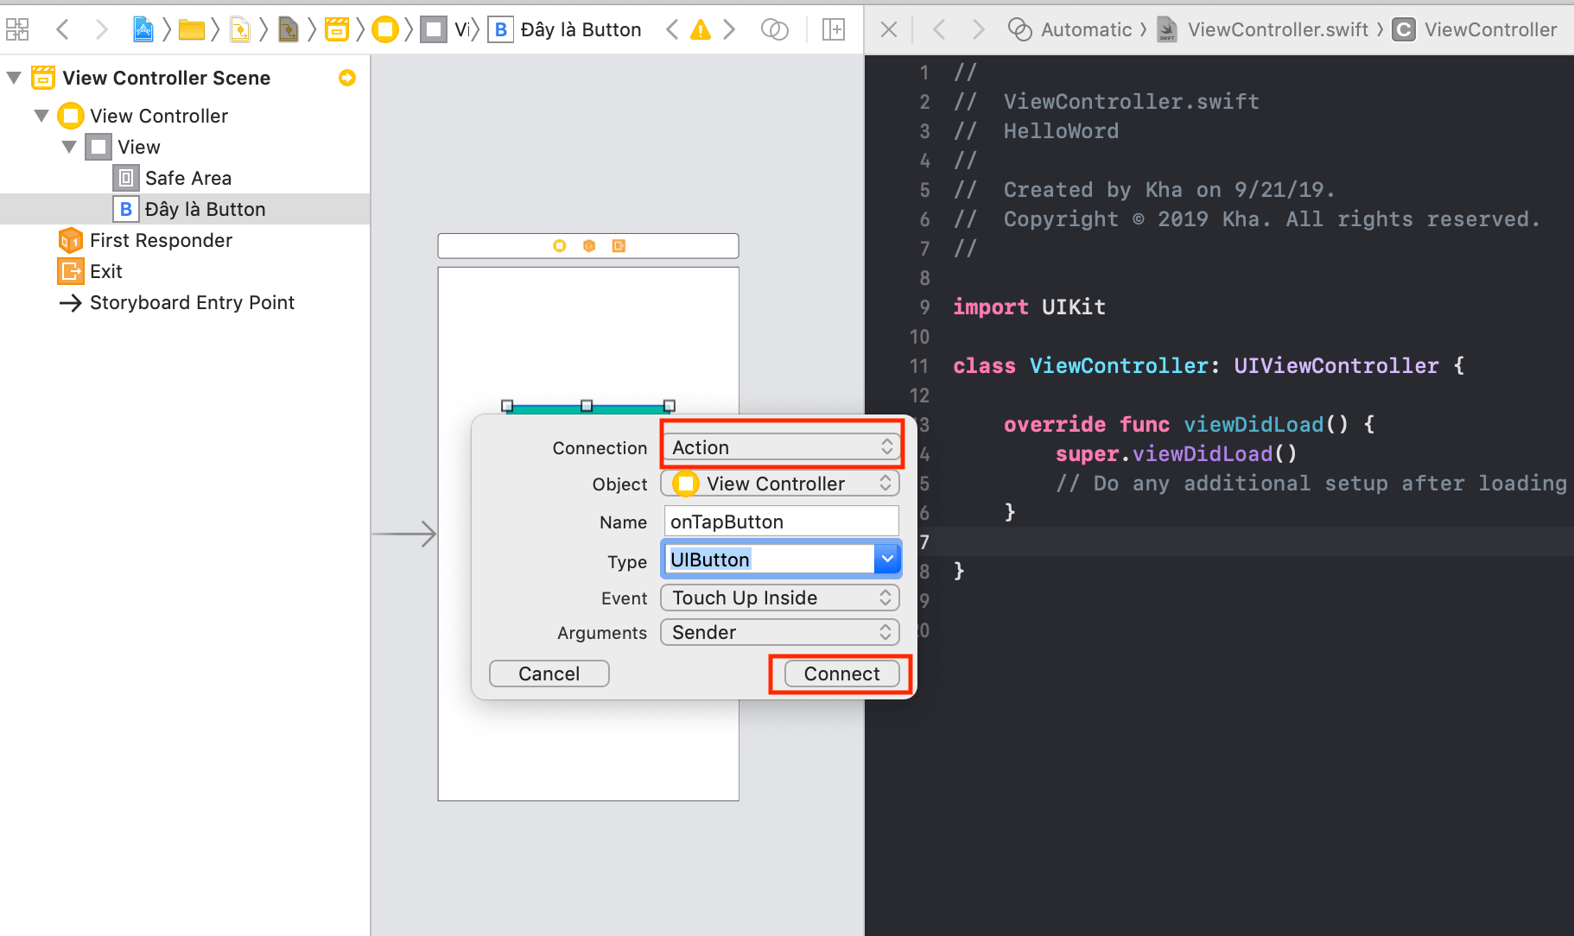

Slide 15
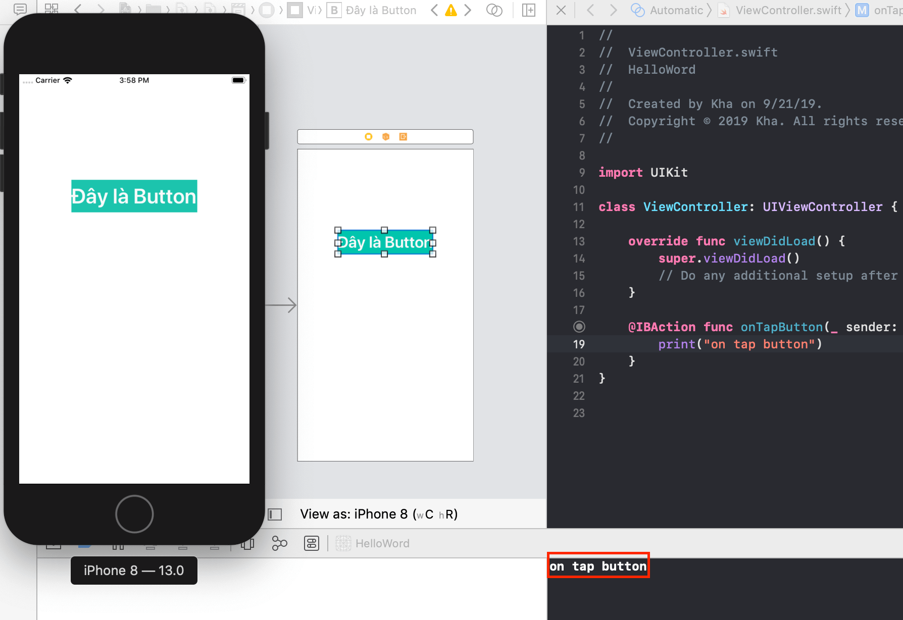

Slide 16
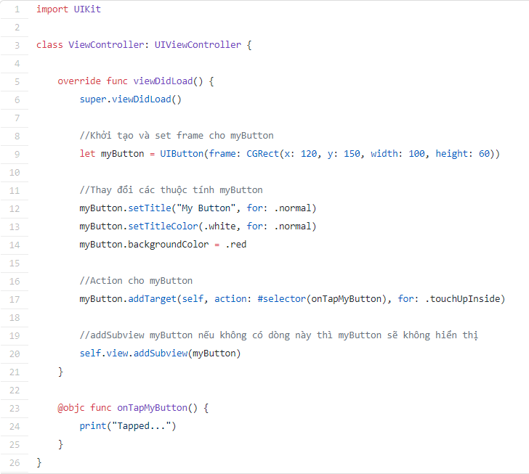
Create UIButton with code

Slide 17
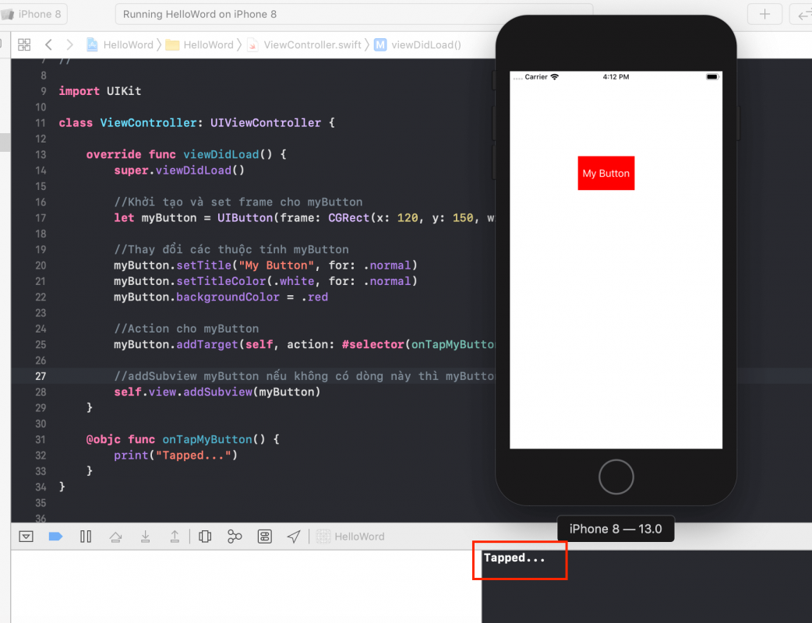

Slide 18
UIDatePicker
❖ A control used for the inputting of date and time values.
❖ You can use a date picker to allow a user to enter either a point in time (calendar date, time value or both) or a time interval (for example for a timer).
❖ The date picker reports interactions to its associated target object.

Slide 19
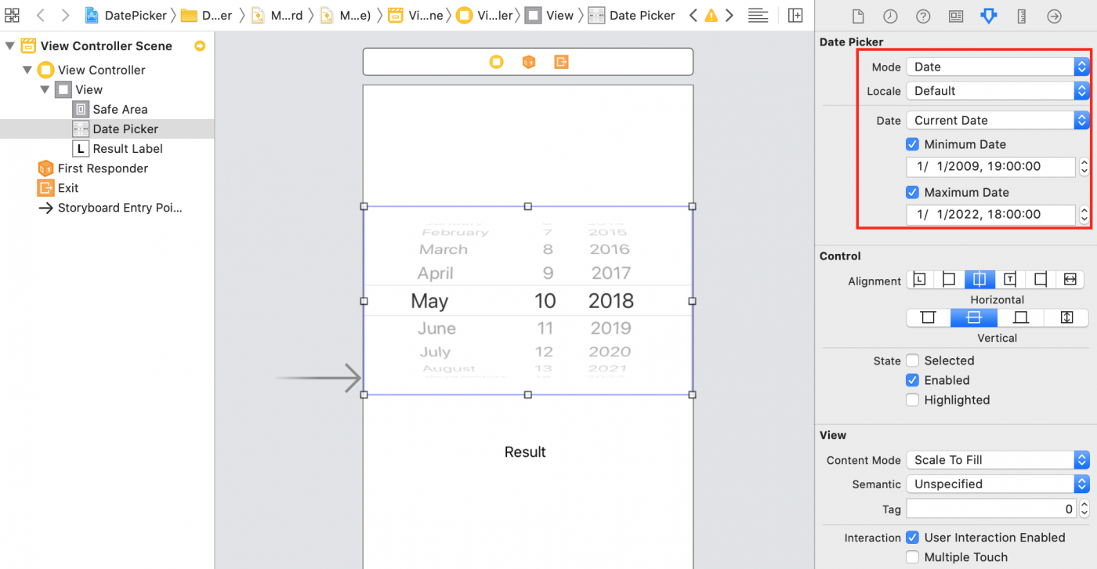
Mode: The display modes of UIDatePicker have 4 types (Time, Date, Date and Time, Count Down Timer).
Locale: date and time of the displayed country.
Date: the date that UIDatePicker is selecting (if Current Date is selected, the current date will be obtained).
Minimum Date: The smallest date displayed.
Maximum Date: the maximum date displayed.

Slide 20
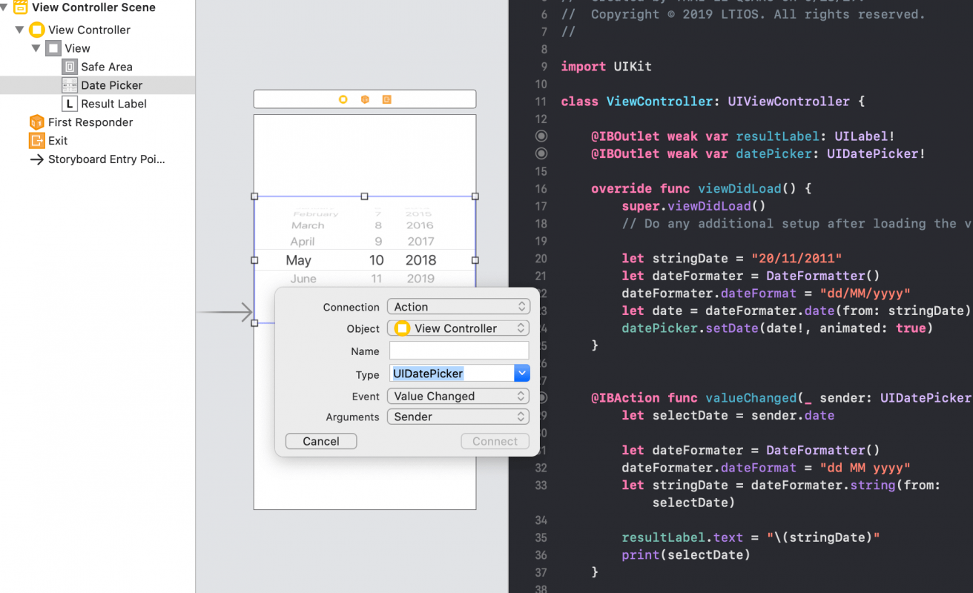
Action and display date format

Slide 21
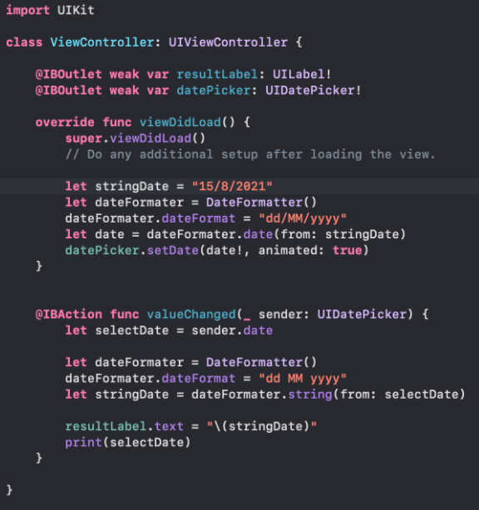

Slide 22
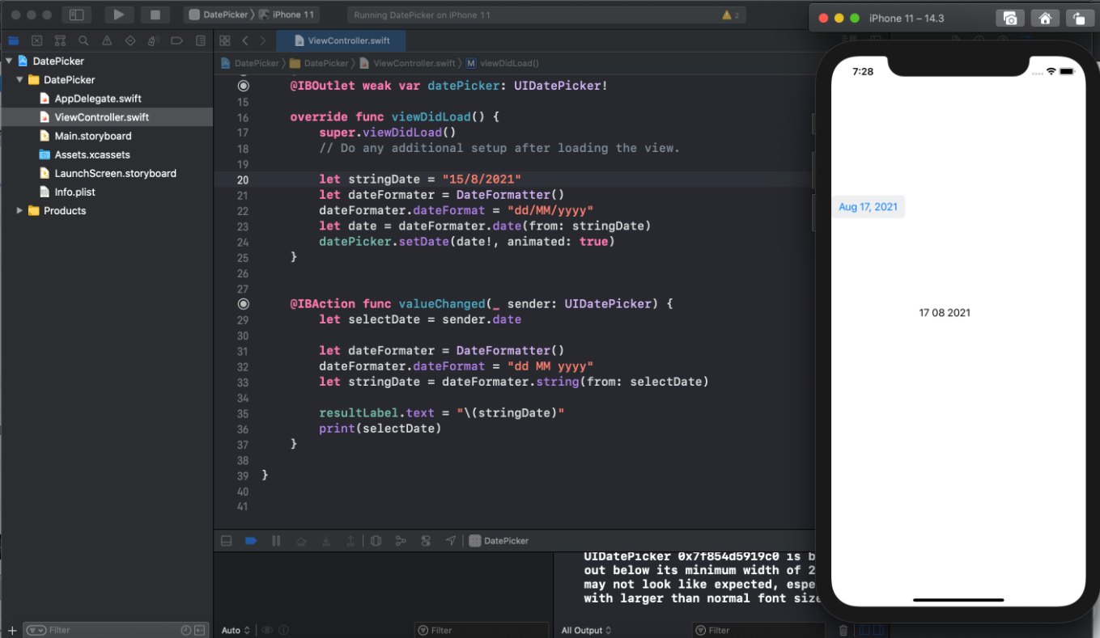

Slide 23
UISegmentedControl
❖ A horizontal control made of multiple segments, each segment functioning as a discrete button.
❖ A segmented control can display a title (an NSString object) or an image (UIImage object). The UISegmentedControl object automatically resizes segments to fit proportionally within their superview unless they have a specific width set.
❖ When you add and remove segments, you can request that the action be animated with sliding and fading effects.

Slide 24
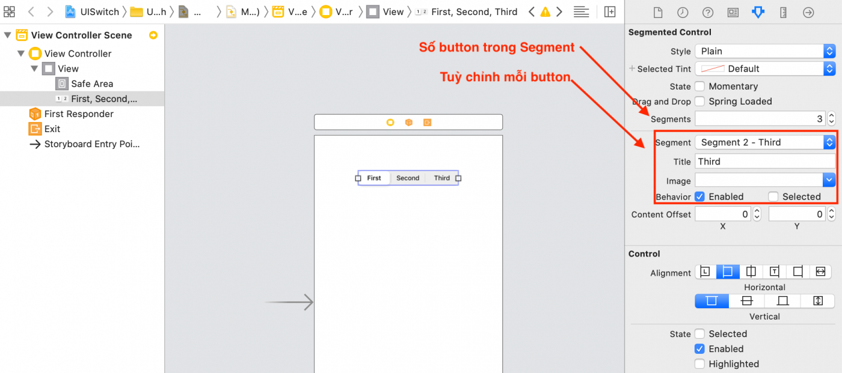
Create UISegmentedControl by drag and drop

Slide 25
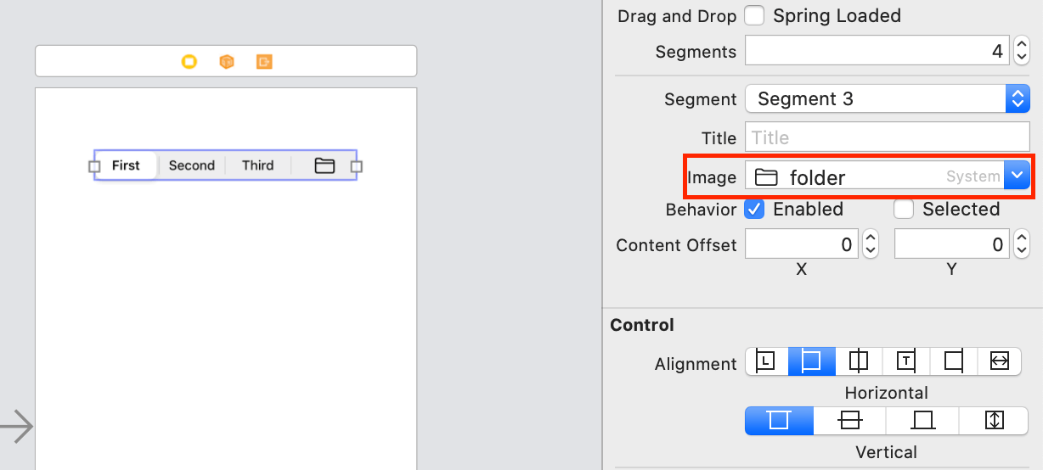

Slide 26
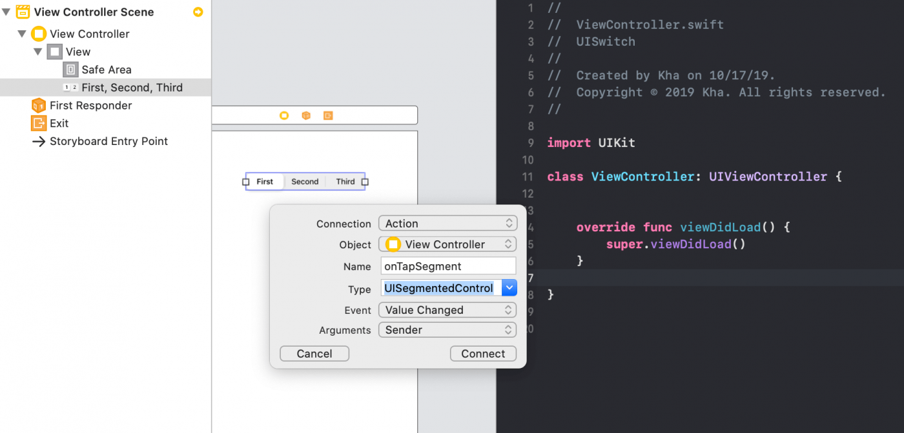

Slide 27
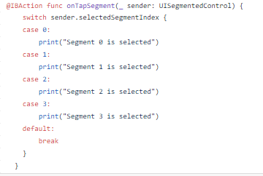

Slide 28
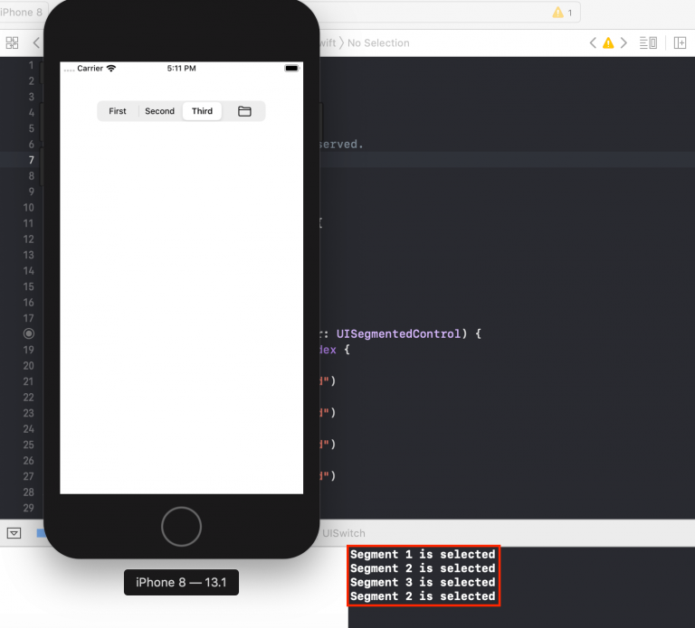

Slide 29
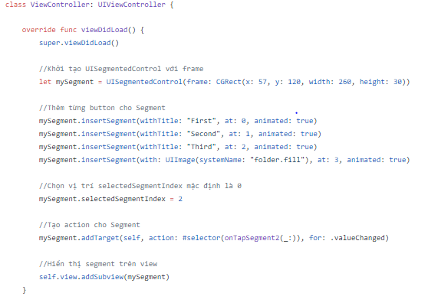
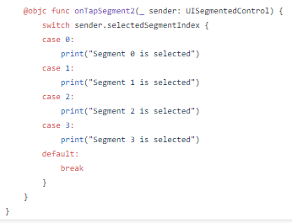
Create UISegmentedControl with code

Slide 30
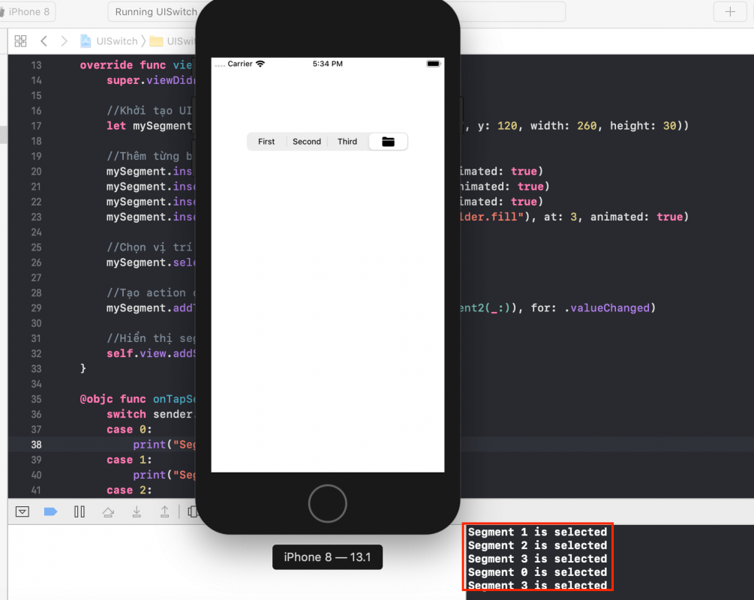

Slide 31
UISlider
❖ A control used to select a single value from a continuous range of values.
❖ As you move the thumb of a slider, it passes its updated value to any actions attached to it. The appearance of sliders is configurable; you can tint the track and the thumb, and provide images to appear at the ends of the slider.

Slide 32
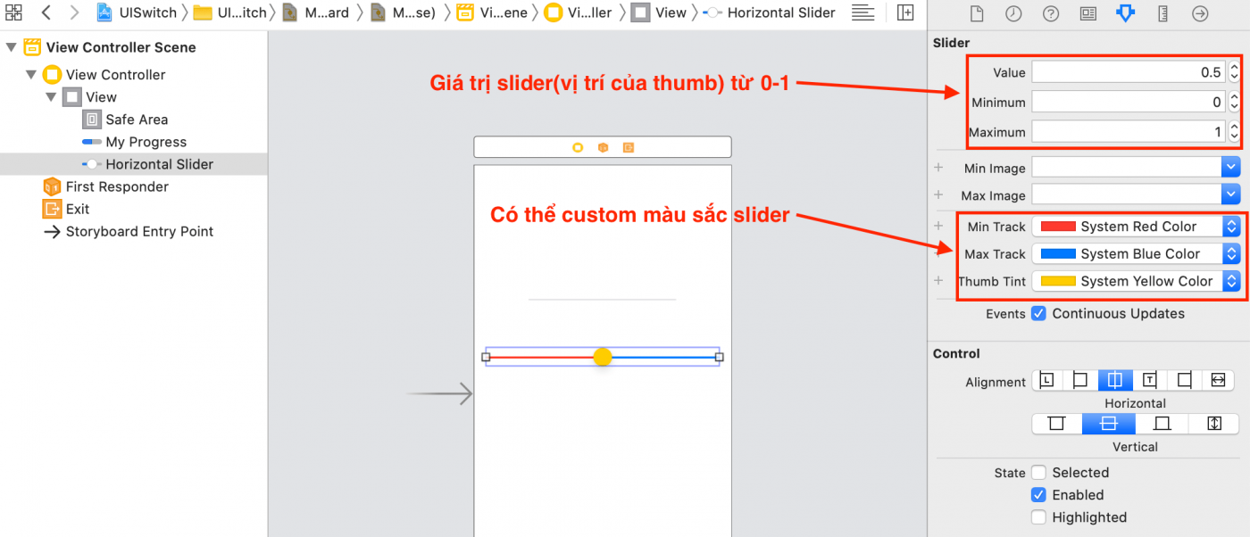
Create UISlider by drag and drop

Slide 33
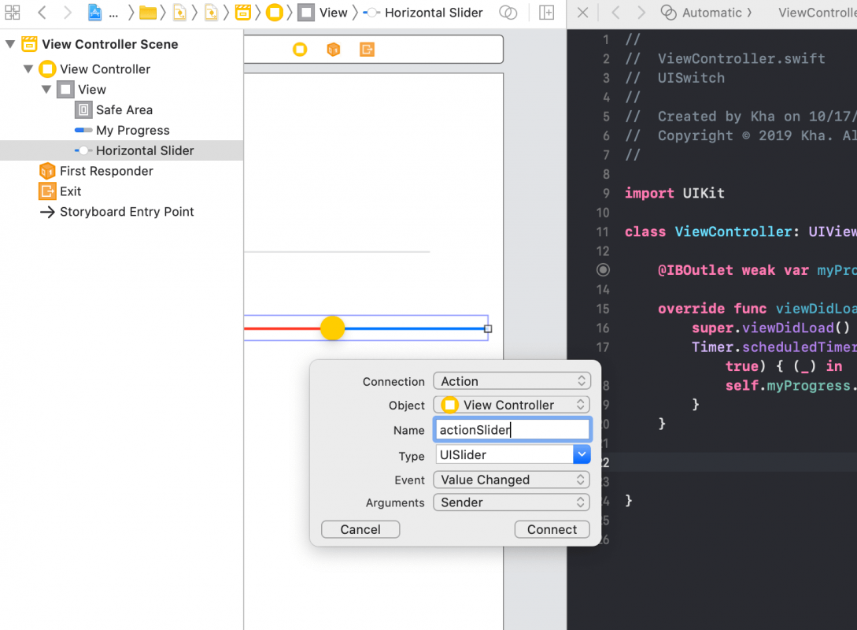

Slide 34
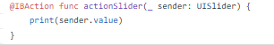
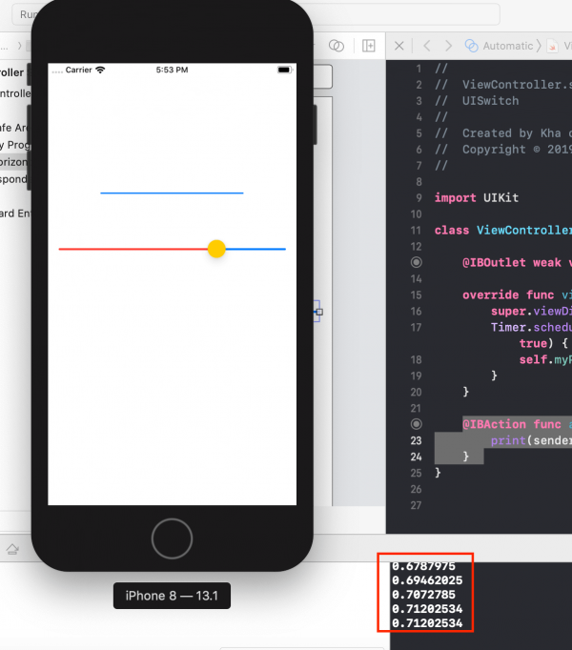

Slide 35
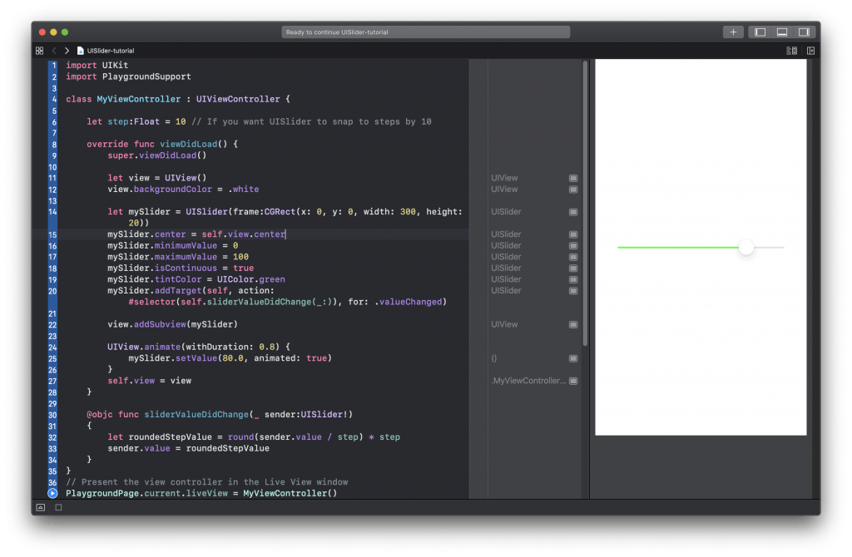
Create UISlider with code

Slide 36
UIStepper
❖ A control used to increment or decrement a value.
❖ If you set stepper behavior to “autorepeat” (which is the default), pressing and holding one of its buttons increments or decrements the stepper’s value repeatedly. The rate of change depends on how long the user continues pressing the control.
❖ The maximum value must be greater than or equal to the minimum value. If you set a maximum or minimum value that would break this invariant, both values are set to the new value.

Slide 37
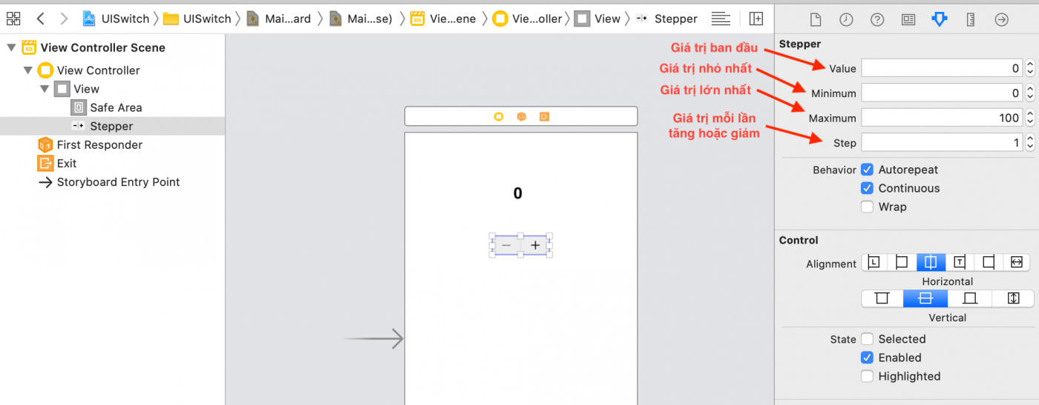
Create UIStepper by drag and drop

Slide 38
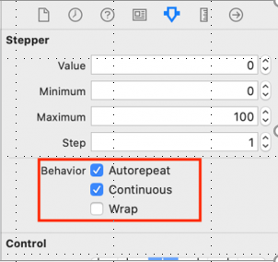
UIStepper also has 3 Behavior :
Autorepeat: the value will automatically increase or decrease when the user presses the corresponding Stepper button.
Continuous: the value of Stepper will update continuously, if unchecked, when the user has finished working with Stepper, the new value will be updated.
Wrap: automatically rotates when Stepper value reaches maximum or minimum.

Slide 39
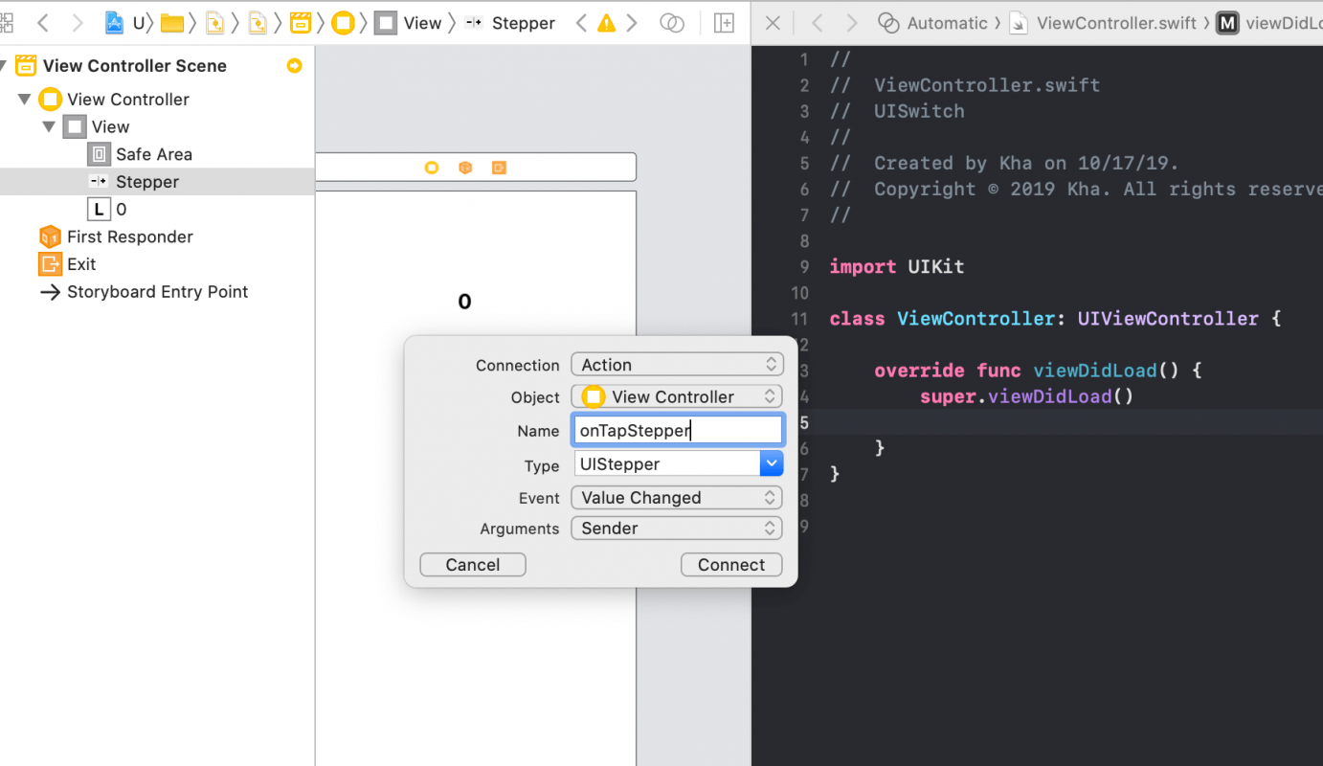

Slide 40
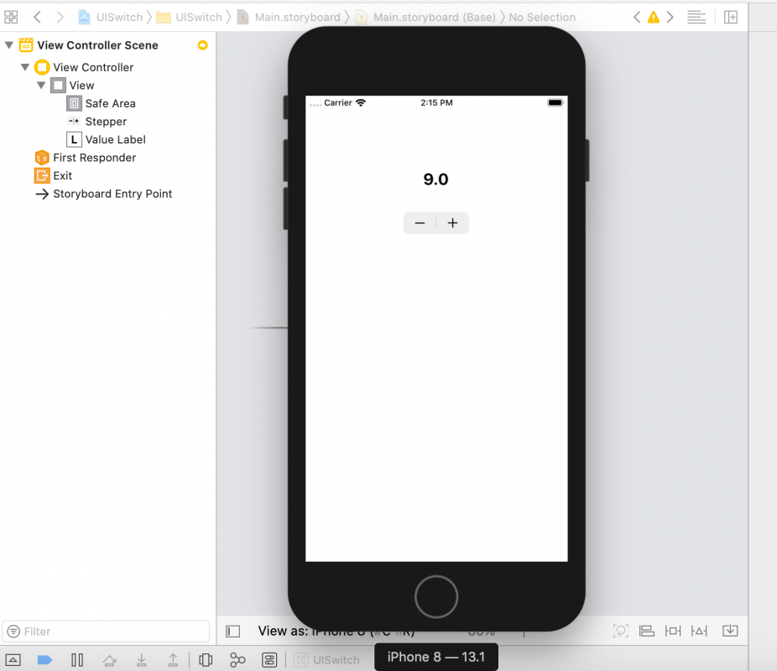

Slide 41
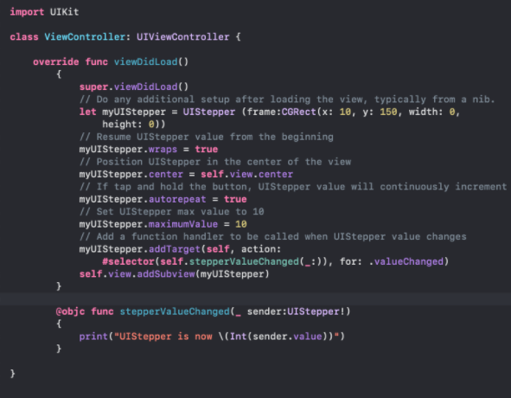
Create UIStepper with code

Slide 42
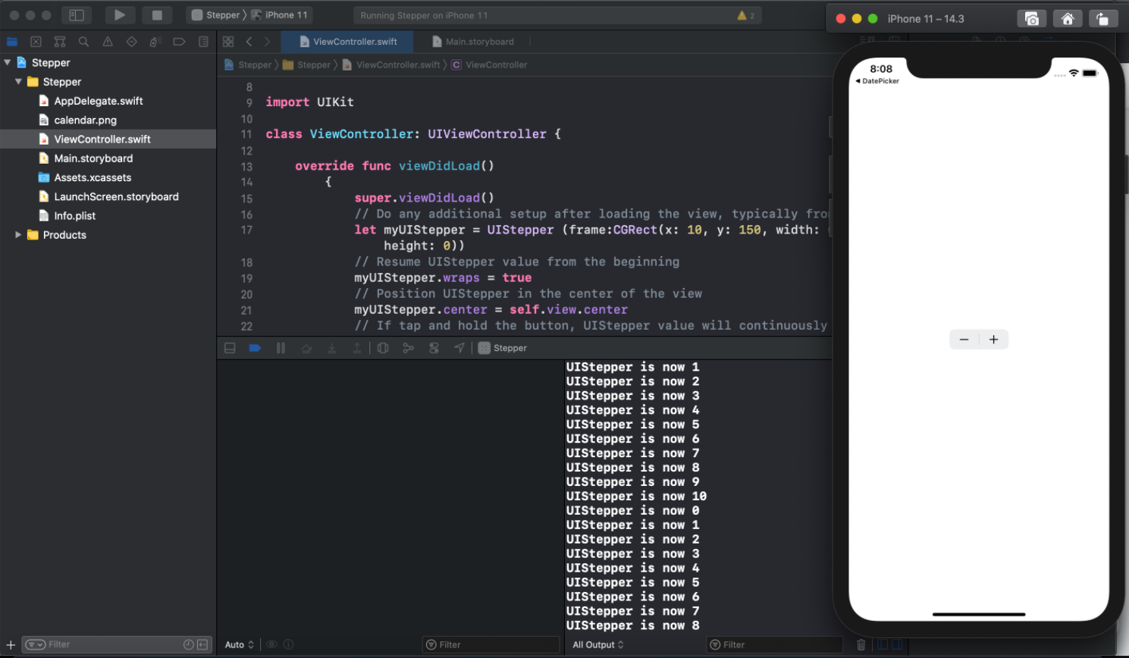

Slide 43
UISwitch
❖ A control that offers a binary choice, such as On/Off.
❖ The UISwitch class declares a property and a method to control its on/off state. As with UISlider, when the user manipulates the switch control (“flips” it) a valueChanged event is generated, which results in the control (if properly configured) sending an action message.
❖ You can customize the appearance of the switch by changing the color used to tint the switch when it is on or off.

Slide 44
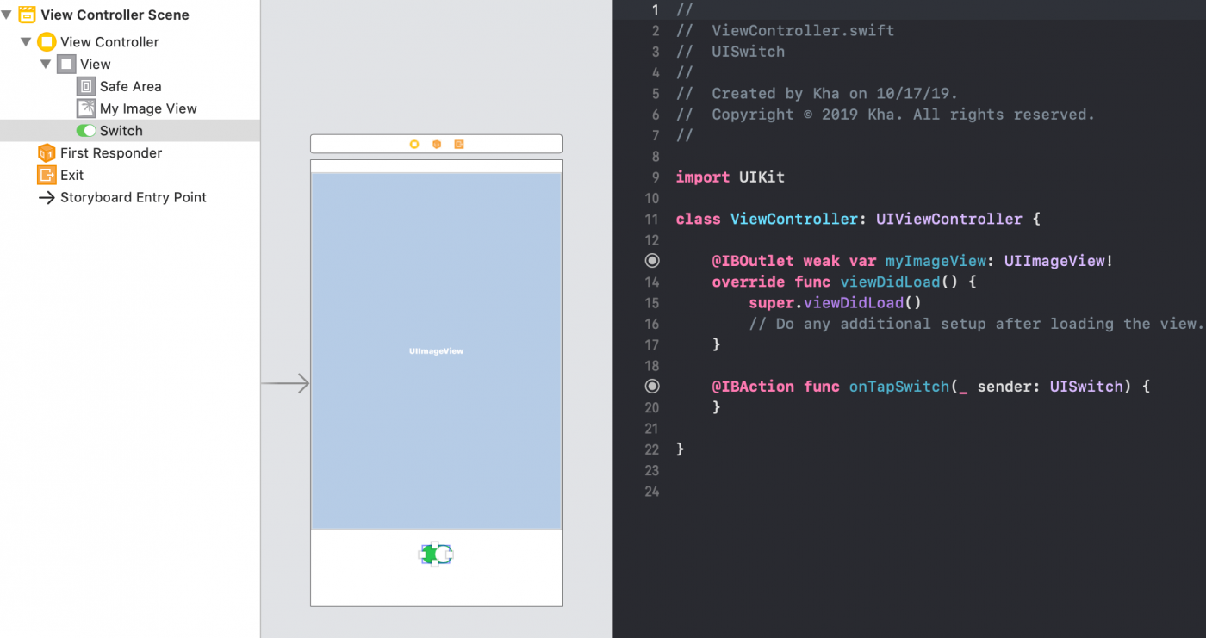
Create UISwitch by drag and drop

Slide 45
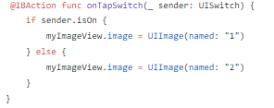
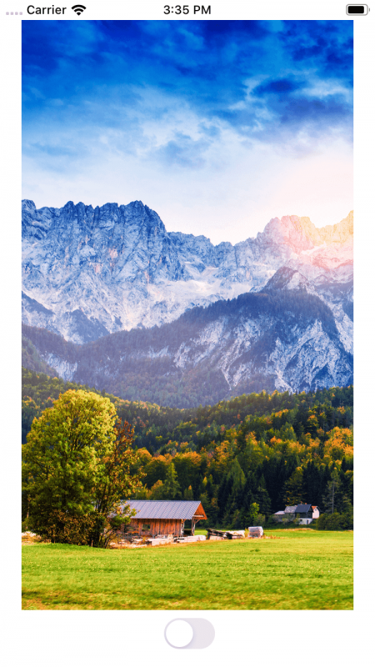
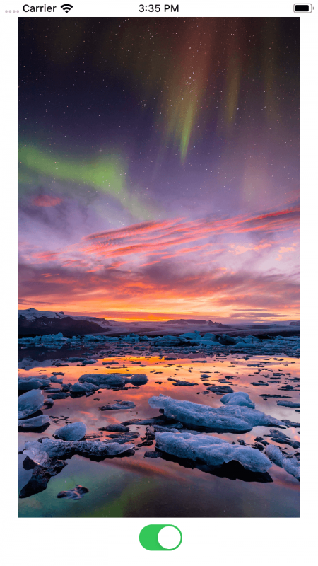

Slide 46
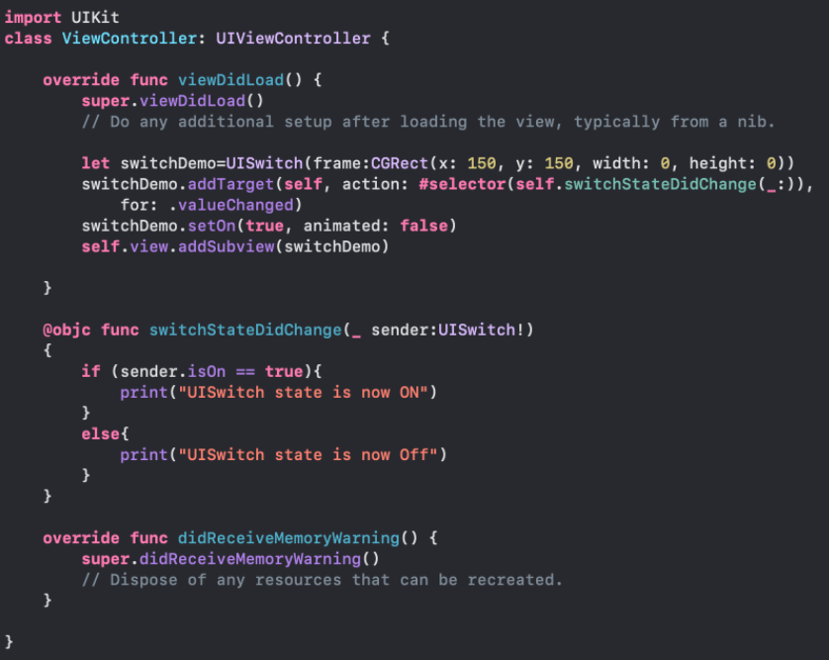
Create UISwitch with code

Slide 47
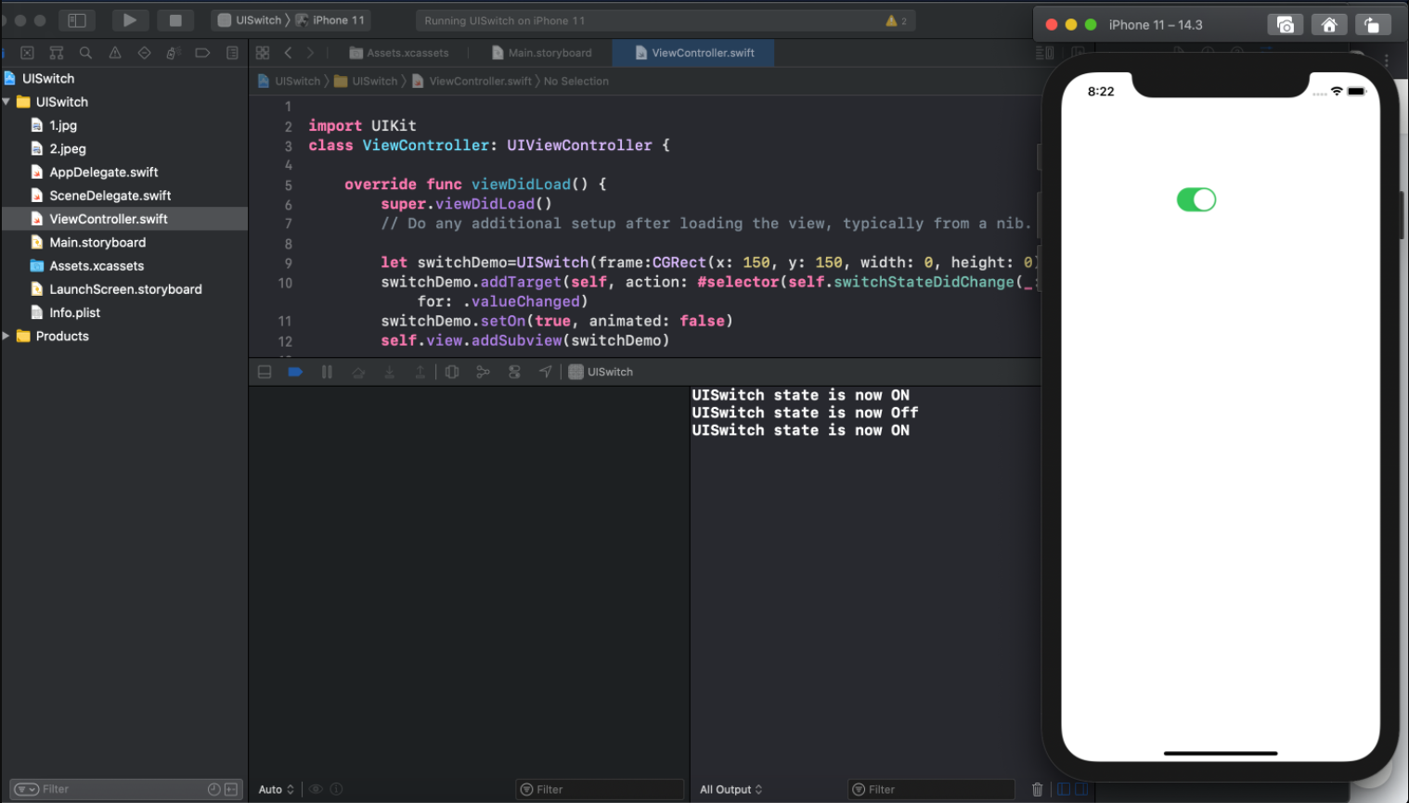

Slide 48


